Slide 1
UNIVERSITY ANALYTICS
SYSTEM
Gulshan Kumar
2320893

Slide 2
INDEX
OBJECTIVE OF THE PROJECT
SOURCE FILES
REQUIREMENTS
DESIGN TARGET AND DEVELOPMENTS
MAPPINGS AND OUTPUTS
CONCLUSION

Slide 3
OBJECTIVE
The purpose of our project is to develop an ETL process using Informatica Power Center to integrate University data from multiple sources into a centralized system for effective University management.

Slide 4
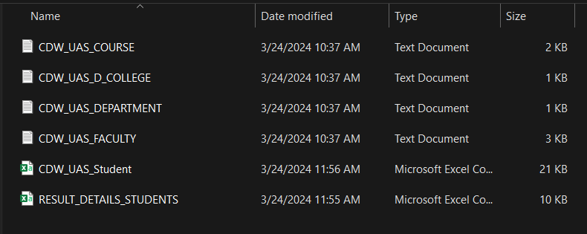
SOURCE FILES
CDW_UAS_COURSE
CDW_UAS_D_COLLEGE
CDW_UAS_DEPARTMENT
CDW_UAS_FACULTY
CDW_UAS_Student
RESULT_DETAILS_STUDENTS

Slide 5
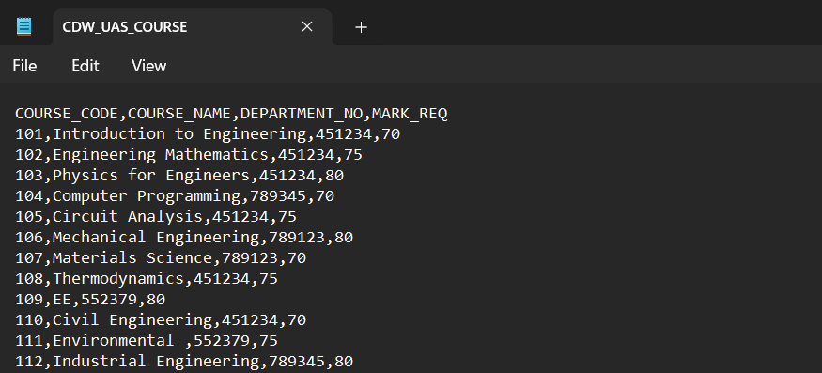
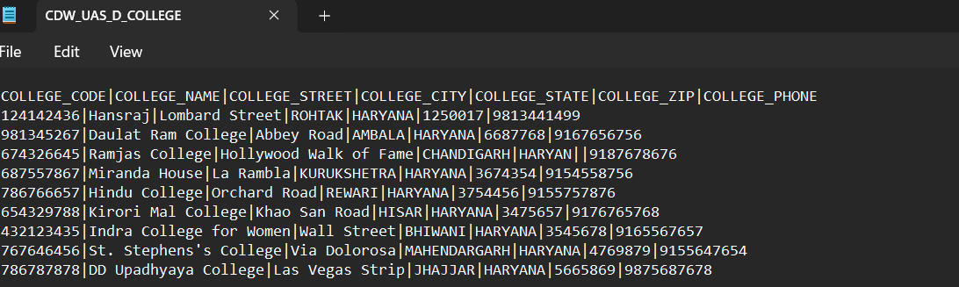
CDW_UAS_COURSE :-
CDW_UAS_D_COLLEGE :-

Slide 6
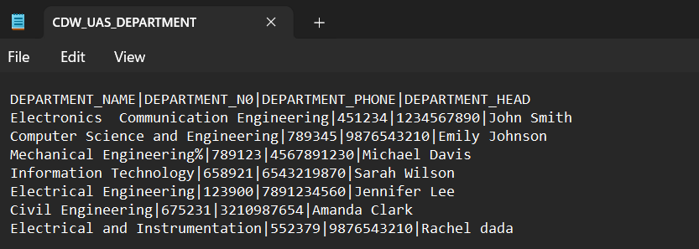
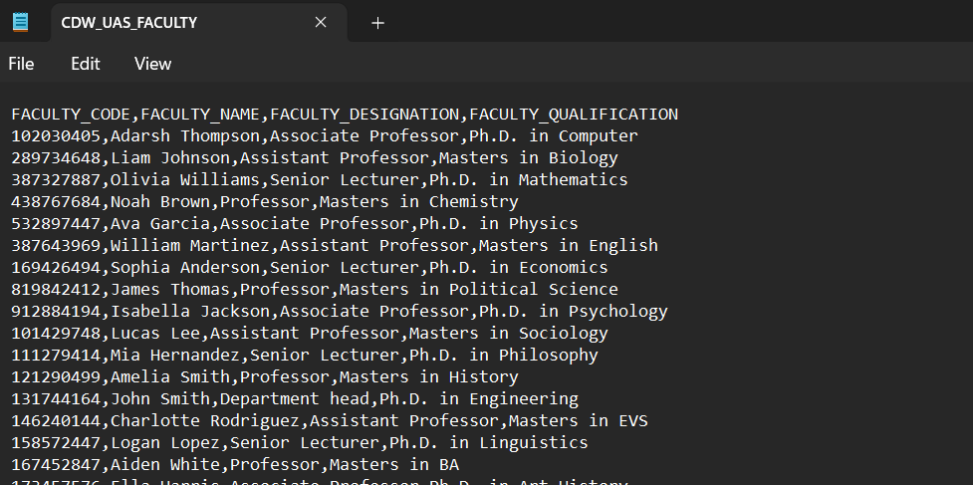
CDW_UAS_DEPARTMENT :-
CDW_UAS_FACULTY :-

Slide 7
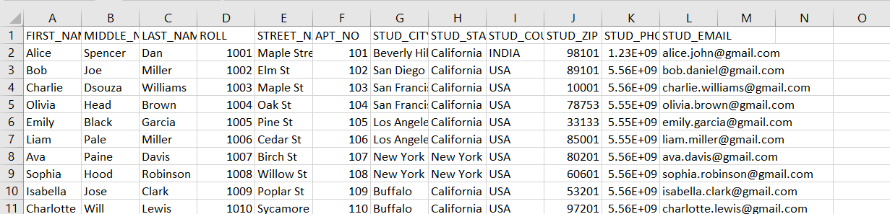
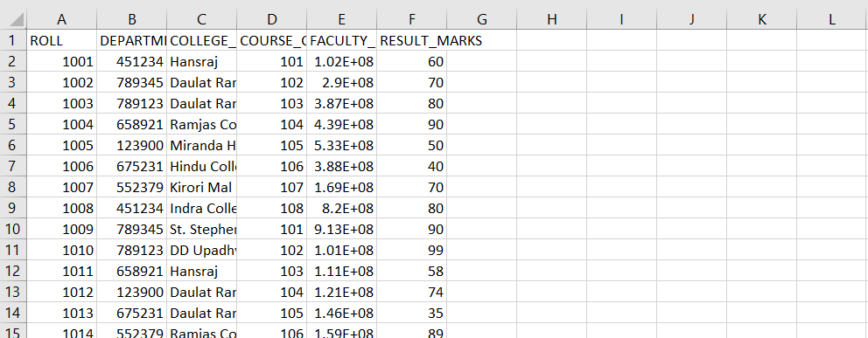
CDW_UAS_Student :-
RESULT_DETAILS_STUDENTS:-

Slide 8
REQUIREMENTS
Requirement 1:-
Student Dimension – The Student dimension table CDW_UAS_D_STUDENT_EFF_DATE is a Type – II SCD table which contains all students’ information. The source file’s name is CDW_UAS_student.csv. The source sends the file on a daily basis. History of the students’ needs to be maintained in the table.
Requirement 2:-
College Dimension - The College dimension table CDW_UAS_D_COLLEGE is a Type – I SCD which contains all college details. Data is added to this table, only when a new college is being opened. So, the load schedule would be on demand. The source file’s name is CDW_UAS_COLLEGE.txt and it is pipe (|) delimited. The table is updated/ inserted for old/ new branches respectively and no history is maintained

Slide 9
Requirement 3:-
Department Dimension - The Department dimension table CDW_UAS_D_DEPARTMENT is a Type – I SCD table which contains all the departments’ information. The source file’s name is CDW_UAS_DEPARTMENT.txt and it is pipe (|) delimited. The table is updated/inserted for old/new suppliers respectively on a daily basis and no history is maintained.
Requirement 4:-
Course Dimension - The course dimension table CDW_UAS_D_COURSE is a Type – I SCD which contains all course information. The source file’s name is CDW_UAS_COURSE.txt and it is comma (,) delimited. This table is dependent on the Department table for the Department Id. The department table must contain the respective department information before loading course table. The table is updated/inserted for old/new products respectively on a daily basis and no history is maintained.

Slide 10
Requirement 5:-
Faculty Dimension - The faculty dimension table CDW_UAS_D_FACULTY is a Type – I SCD which contains all faculty details. The source file’s name is CDW_UAS_FACULTY.txt and it is comma (,) delimited. The table is updated/ inserted for old/ new branches respectively and no history is maintained
Requirement 6:-
Results Staging - The results staging table CDW_STG_RESULT receives the results data from the different evaluation centers RESULT_DETAILS_STUDENTS.csv. The information from different files is standardized in the staging table. The data is loaded with all related dimension information from the respective dimension tables in the warehouse.

Slide 11
Requirement 7:-
Results Fact - The results fact table CDW_UAS_F_RESULTS contains all the transactions loaded from the staging table CDW_STG_RESULTS. This table is loaded only after the staging table has been loaded completely from the transaction files arriving from all the different centers.
Requirement 8:-
Results Aggregate - The Sales Aggregate table CDW_UAS_F_AGG_DATA pulls data from the Results fact table CDW_UAS_F_RESULTS. The table is aggregated by college_code &course_code .

Slide 12
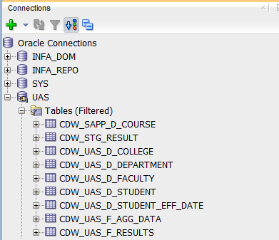
DESIGN TARGET AND DEVELOPMENTS
As per the requirements I have created target tables in sql developer as shown below:-

Slide 13
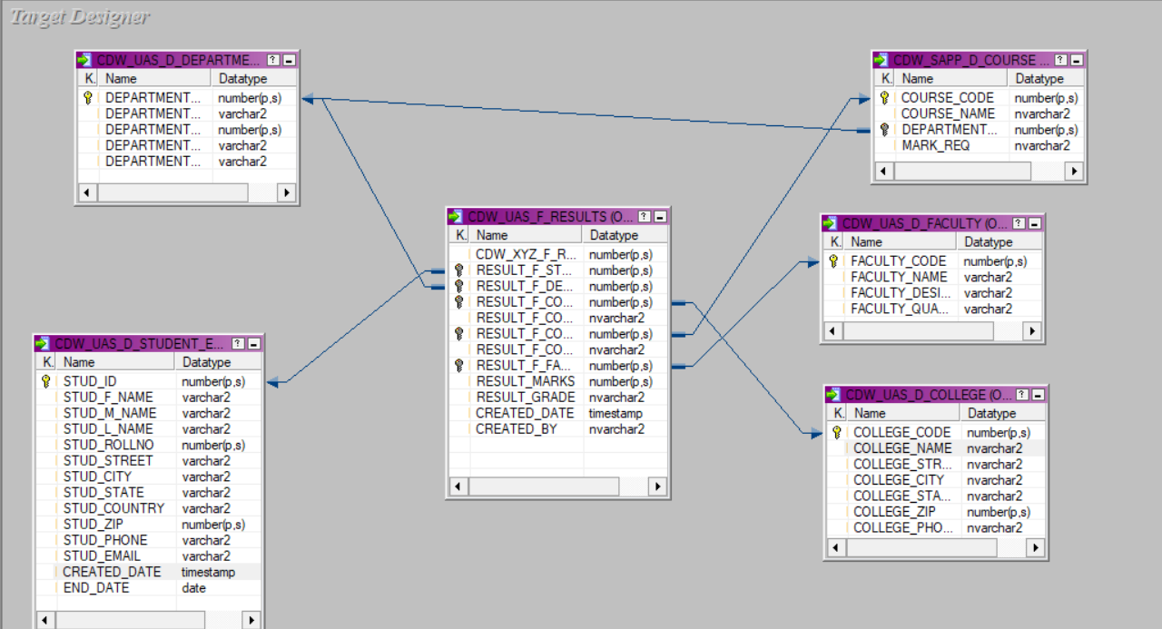
DATA MODELING

Slide 14
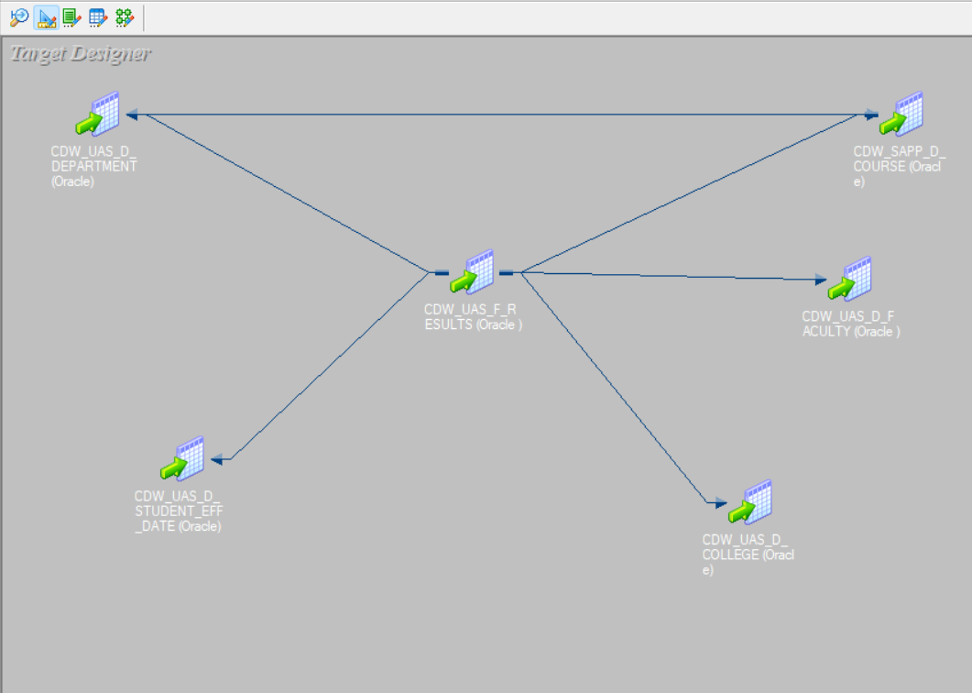
ICONIZE DATA MODEL :-

Slide 15
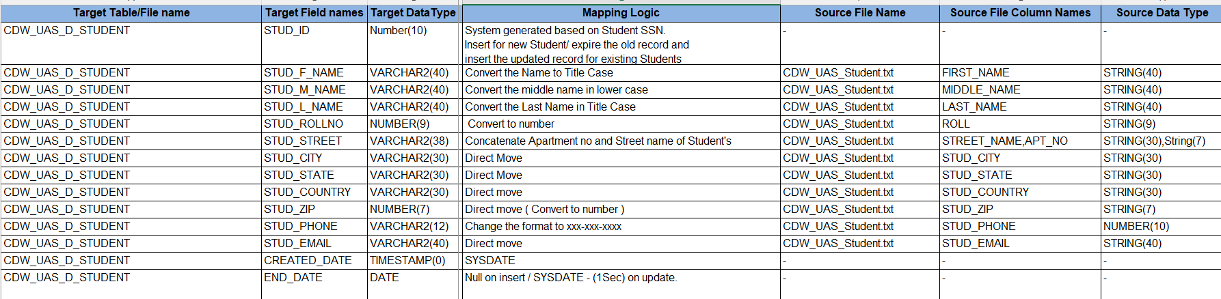
Mapping 1:-
CDW_UAS_student.csv CDW_UAS_D_STUDENT_EFF_DATE
Logic Used :-

Slide 16
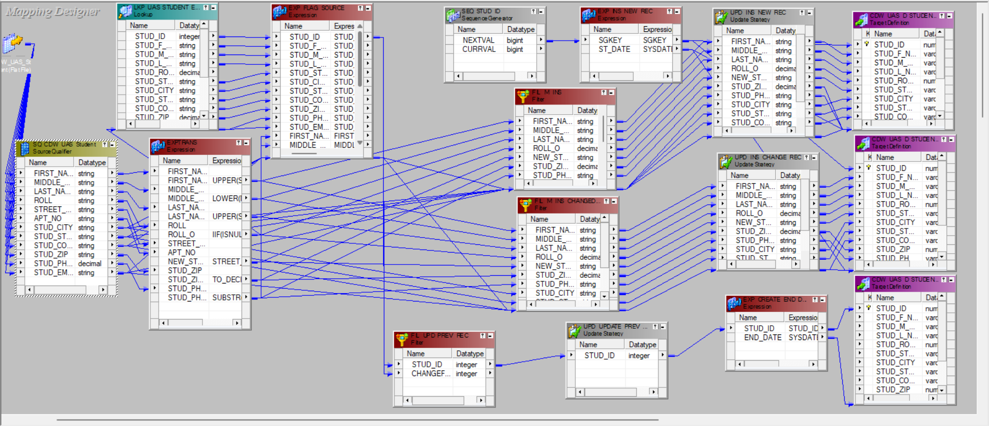
Mapping 1:-
CDW_UAS_student.csv CDW_UAS_D_STUDENT_EFF_DATE

Slide 17
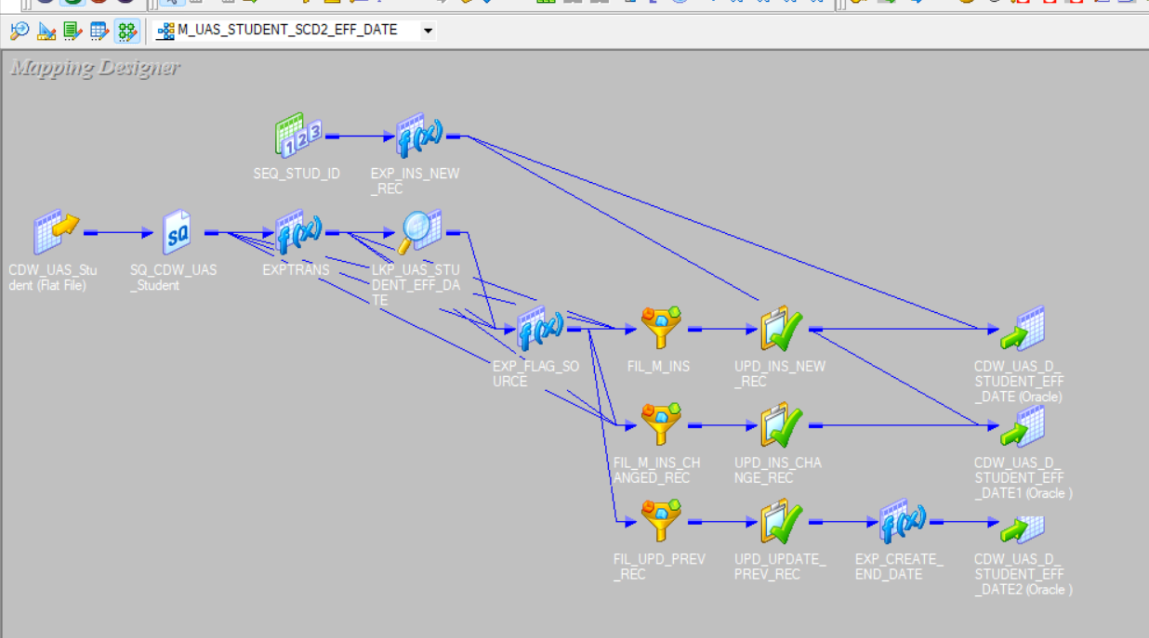
Iconize Mapping 1:-

Slide 18
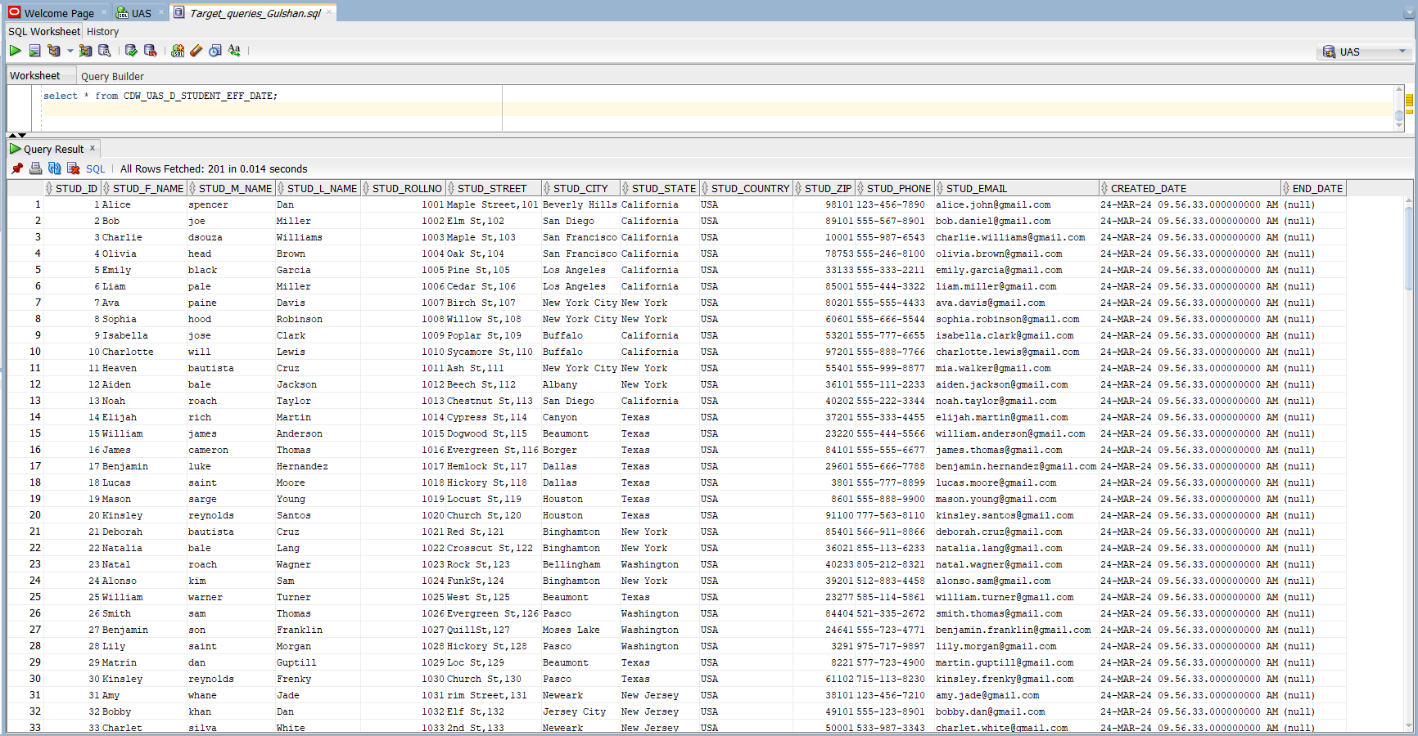
OUTPUT M1 :-

Slide 20
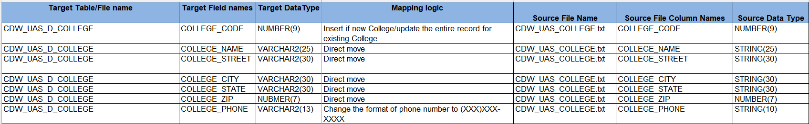
Mapping 2 :-
CDW_UAS_COLLEGE.txt CDW_UAS_D_COLLEGE
Logic Used :-

Slide 21
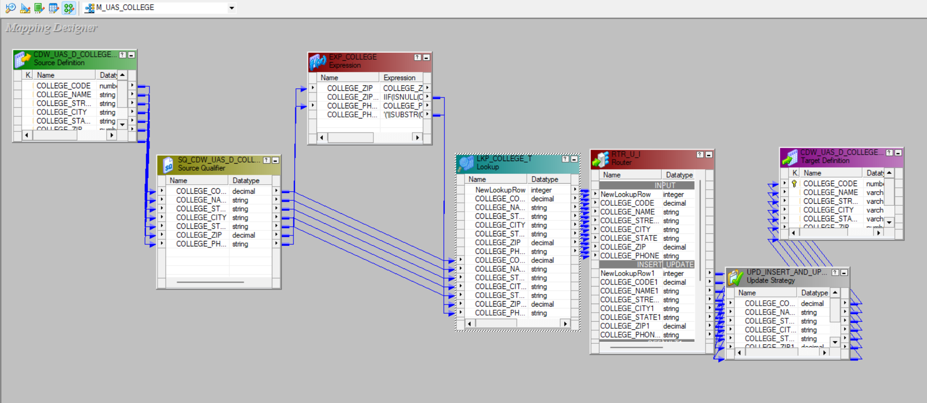
Mapping 2 :-
CDW_UAS_COLLEGE.txt CDW_UAS_D_COLLEGE

Slide 22
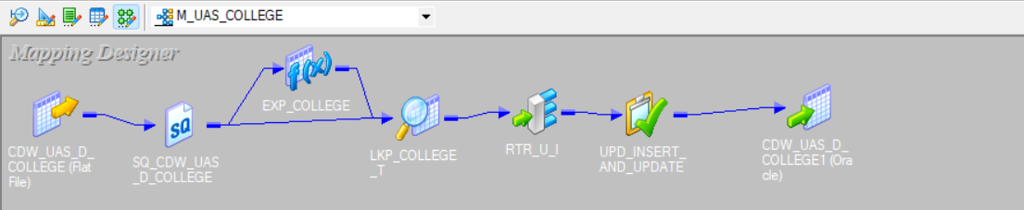
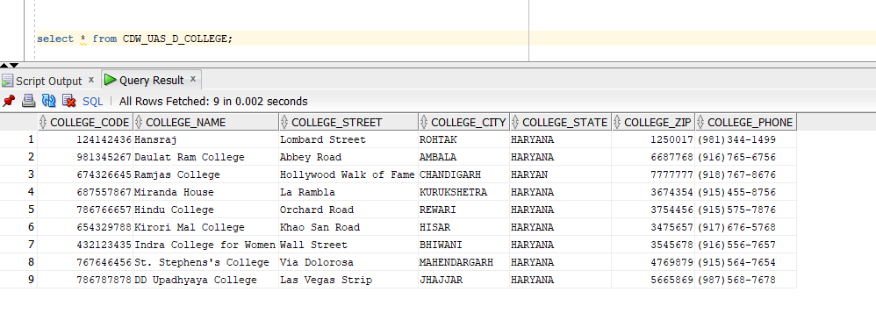
Iconize Mapping 2 :-
OUTPUT M2 :-

Slide 23
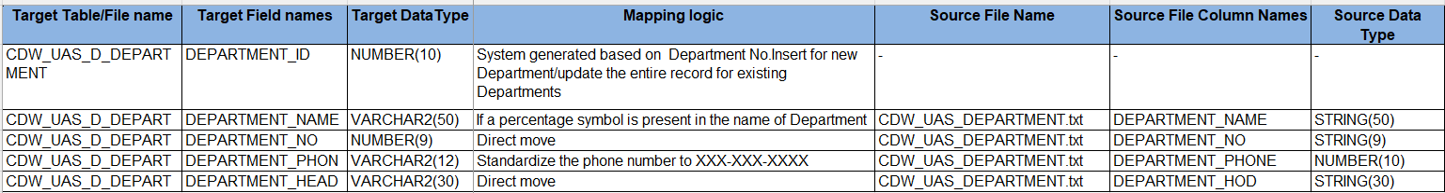
Mapping 3 :-
CDW_UAS_DEPARTMENT.txt CDW_UAS_D_DEPARTMENT
Logic Used :-

Slide 24
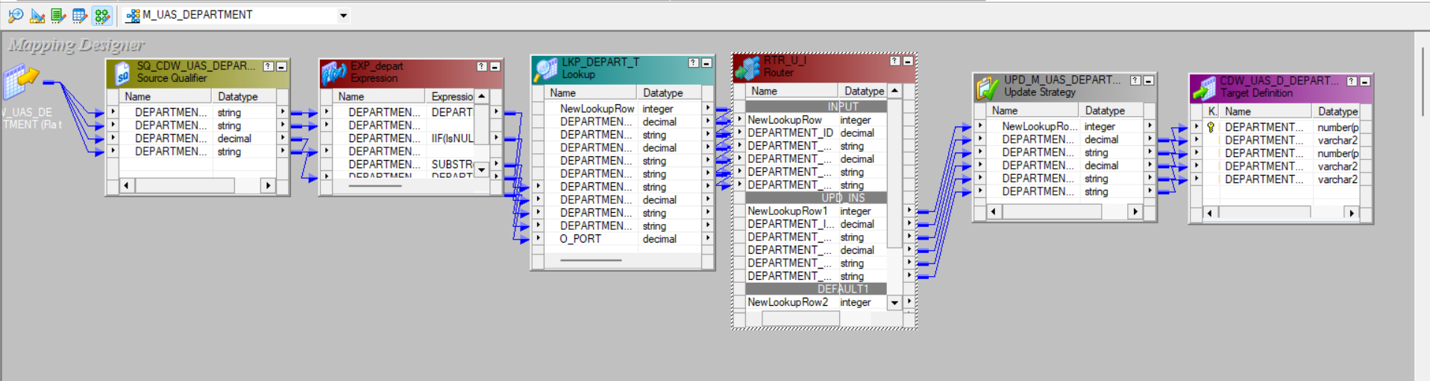
Mapping 3 :-
CDW_UAS_DEPARTMENT.txt CDW_UAS_D_DEPARTMENT

Slide 25
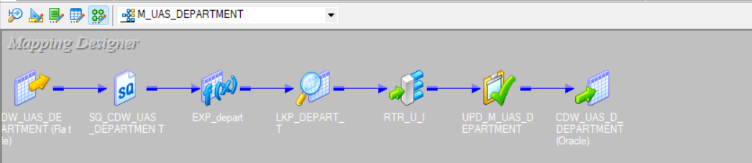
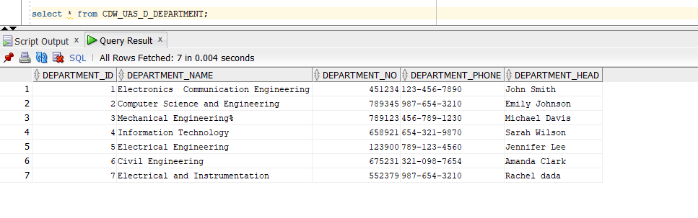
Iconize Mapping 3:-
OUTPUT M3:-

Slide 26
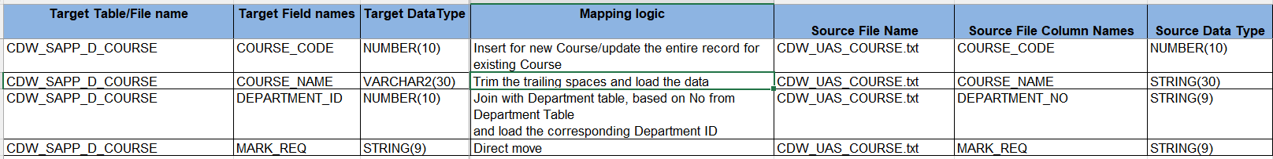
Mapping 4:-
CDW_UAS_COURSE.txt CDW_UAS_D_COURSE
Logic Used :-

Slide 27
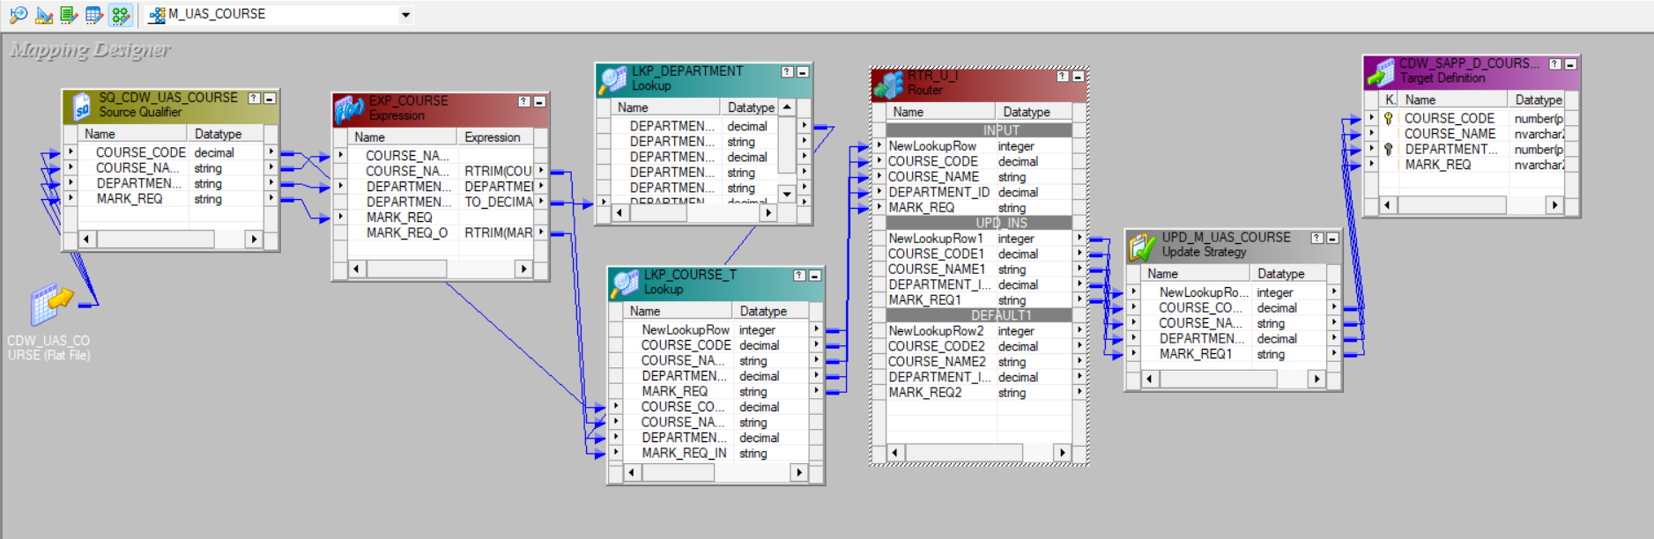
Mapping 4:-
CDW_UAS_COURSE.txt CDW_UAS_D_COURSE

Slide 28
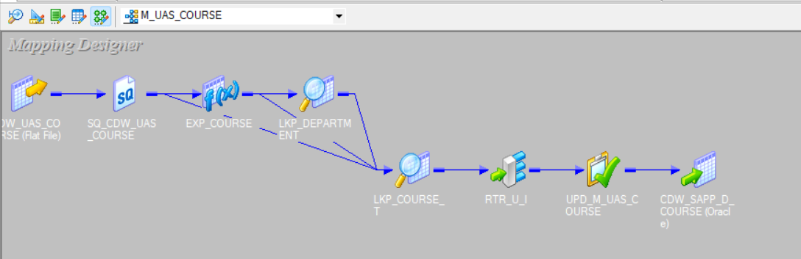
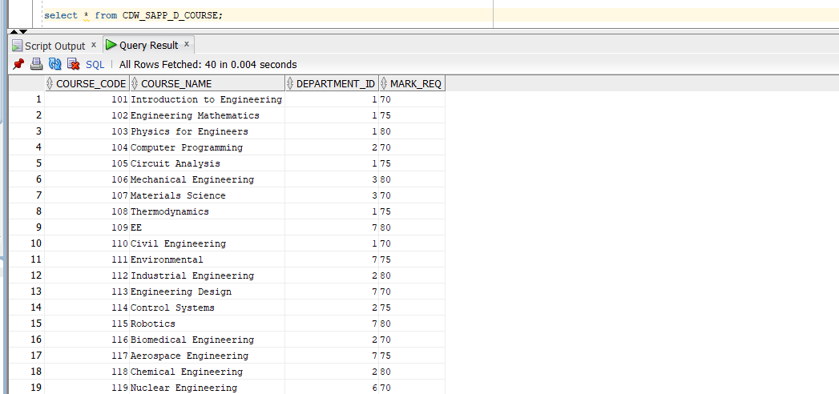
Iconize Mapping 4:-
OUTPUT M4 :-

Slide 29
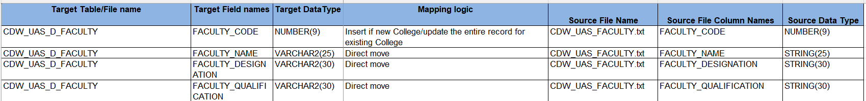
Mapping 5:-
CDW_UAS_FACULTY.txt CDW_UAS_D_FACULTY
Logic Used :-

Slide 30
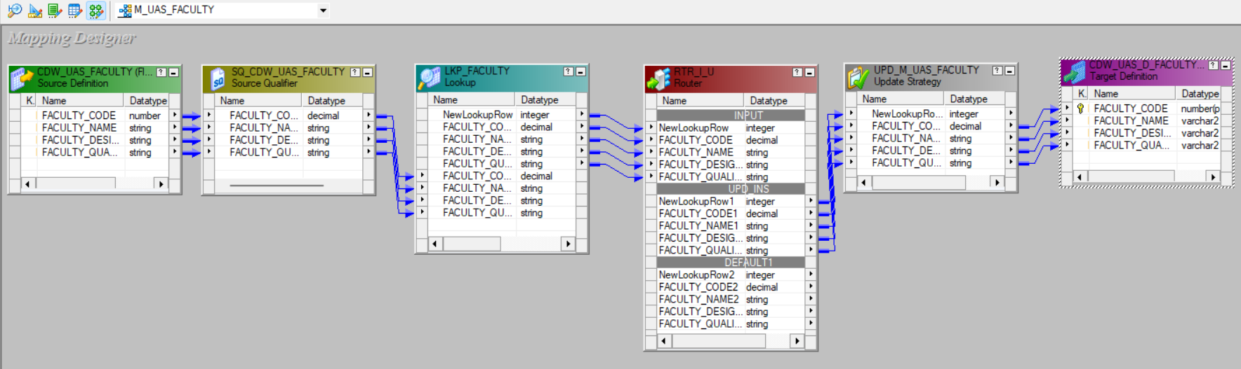
Mapping 5:-
CDW_UAS_FACULTY.txt CDW_UAS_D_FACULTY

Slide 31
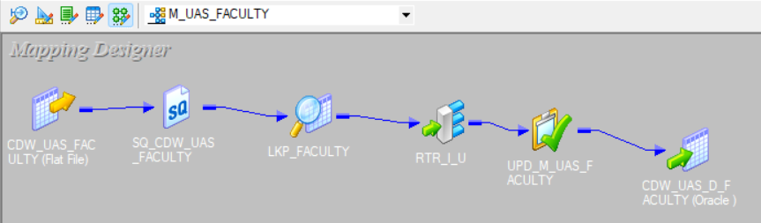
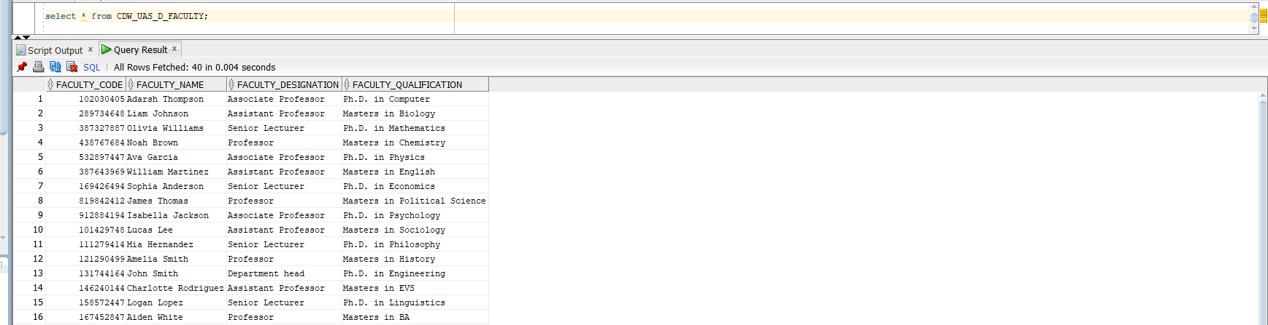
Iconize Mapping 5 :-
OUTPUT M5 :-

Slide 32
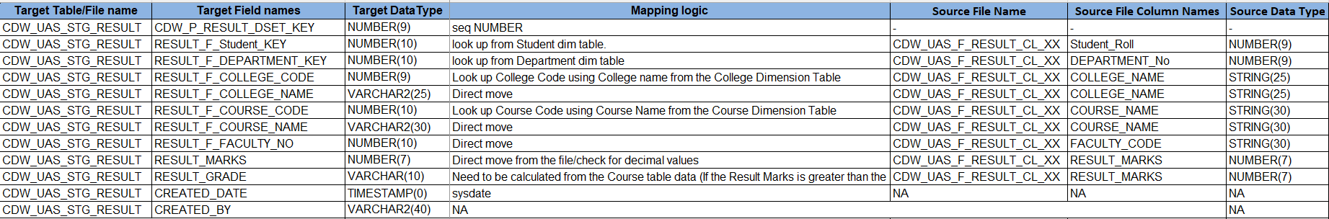
Mapping 6 :-
RESULT_DETAILS_STUDENTS.csv CDW_STG_RESULT
Logic Used :-

Slide 33
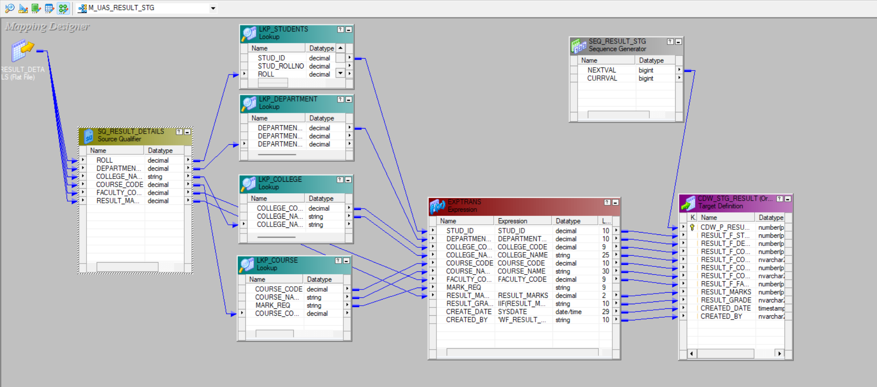
Mapping 6 :-
RESULT_DETAILS_STUDENTS.csv CDW_STG_RESULT

Slide 34
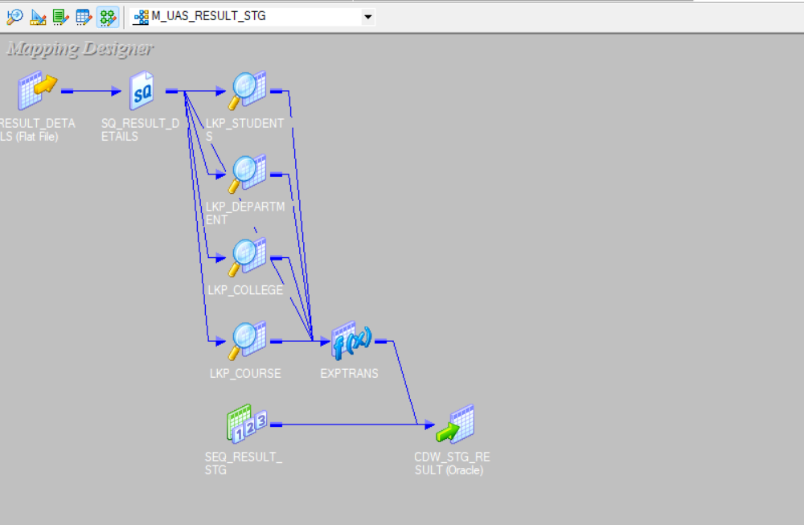
Iconize Mapping 6 :-

Slide 35
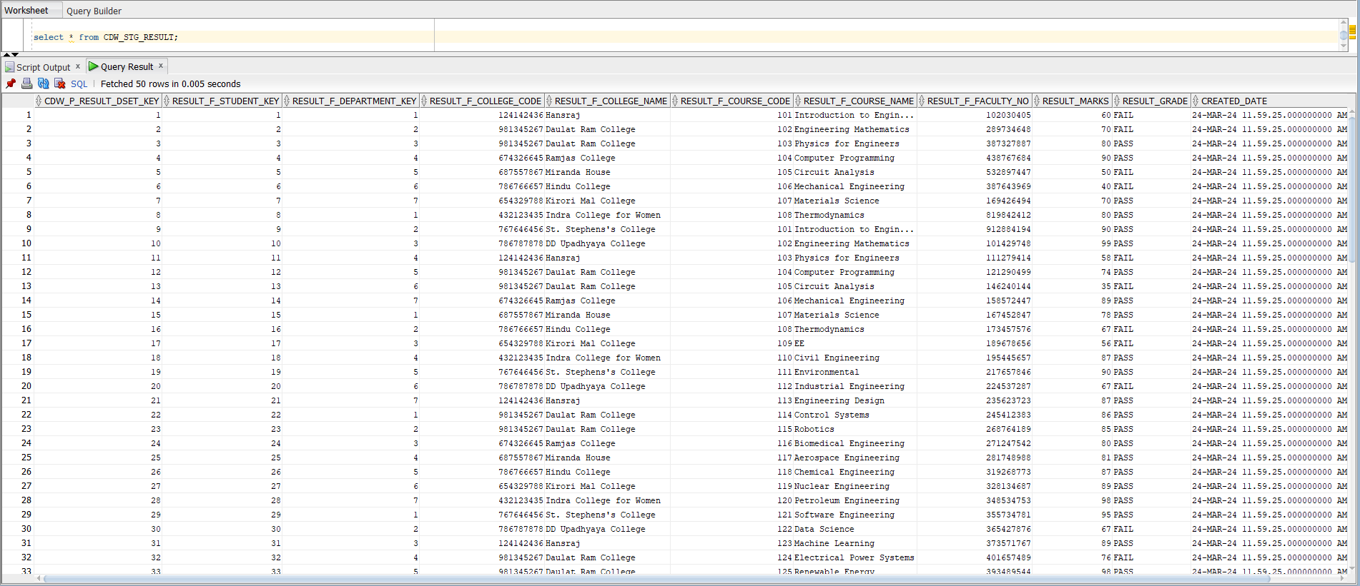
OUTPUT M6 :-

Slide 36
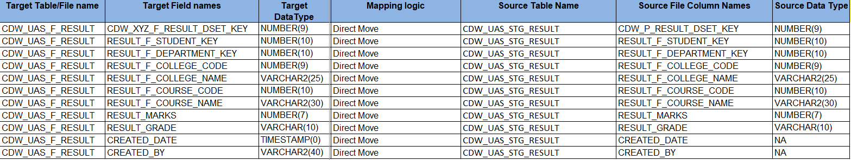
Mapping 7 :-
CDW_STG_RESULTS CDW_UAS_F_RESULTS
Logic Used :-

Slide 37
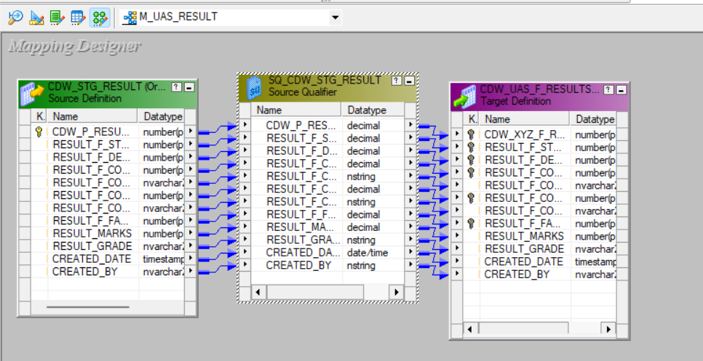
Mapping 7 :-
CDW_STG_RESULTS CDW_UAS_F_RESULTS

Slide 38
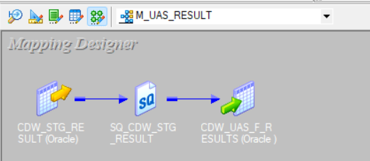
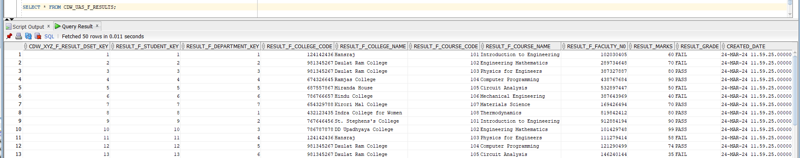
Iconize Mapping 7 :-
OUTPUT M7 :-

Slide 39
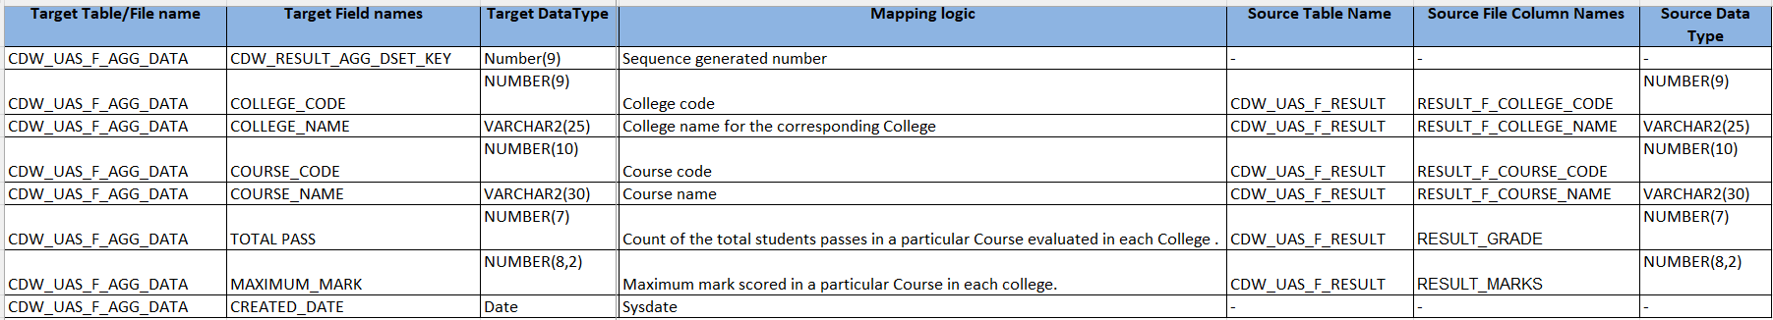
Mapping 8 :-
CDW_UAS_F_RESULTS CDW_UAS_F_AGG_DATA
Logic Used :-

Slide 40
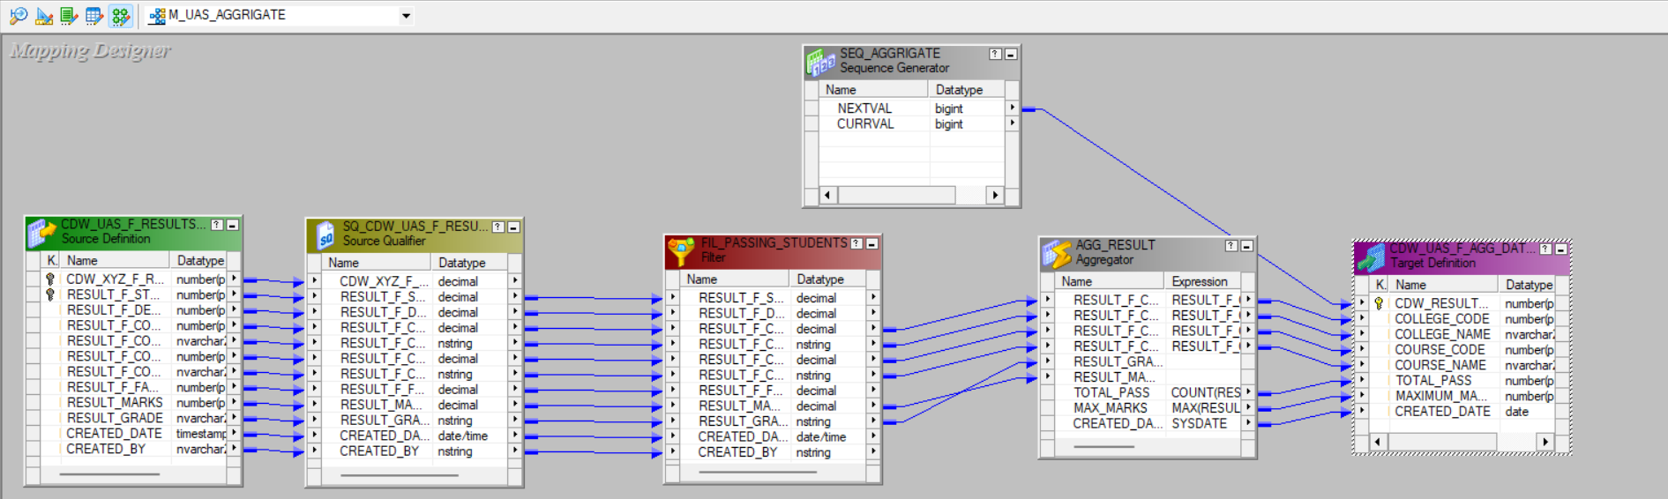
Mapping 8 :-
CDW_UAS_F_RESULTS CDW_UAS_F_AGG_DATA

Slide 41
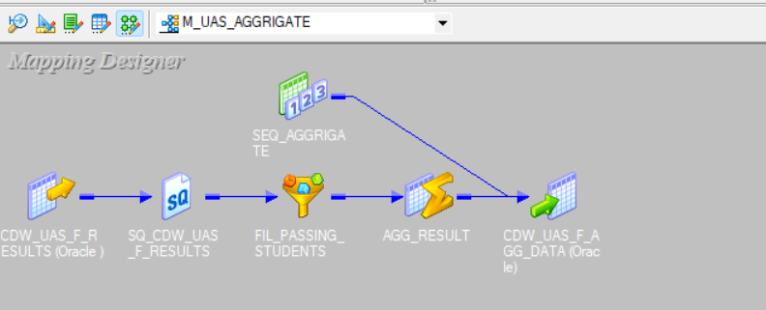
Iconize Mapping 8 :-

Slide 42
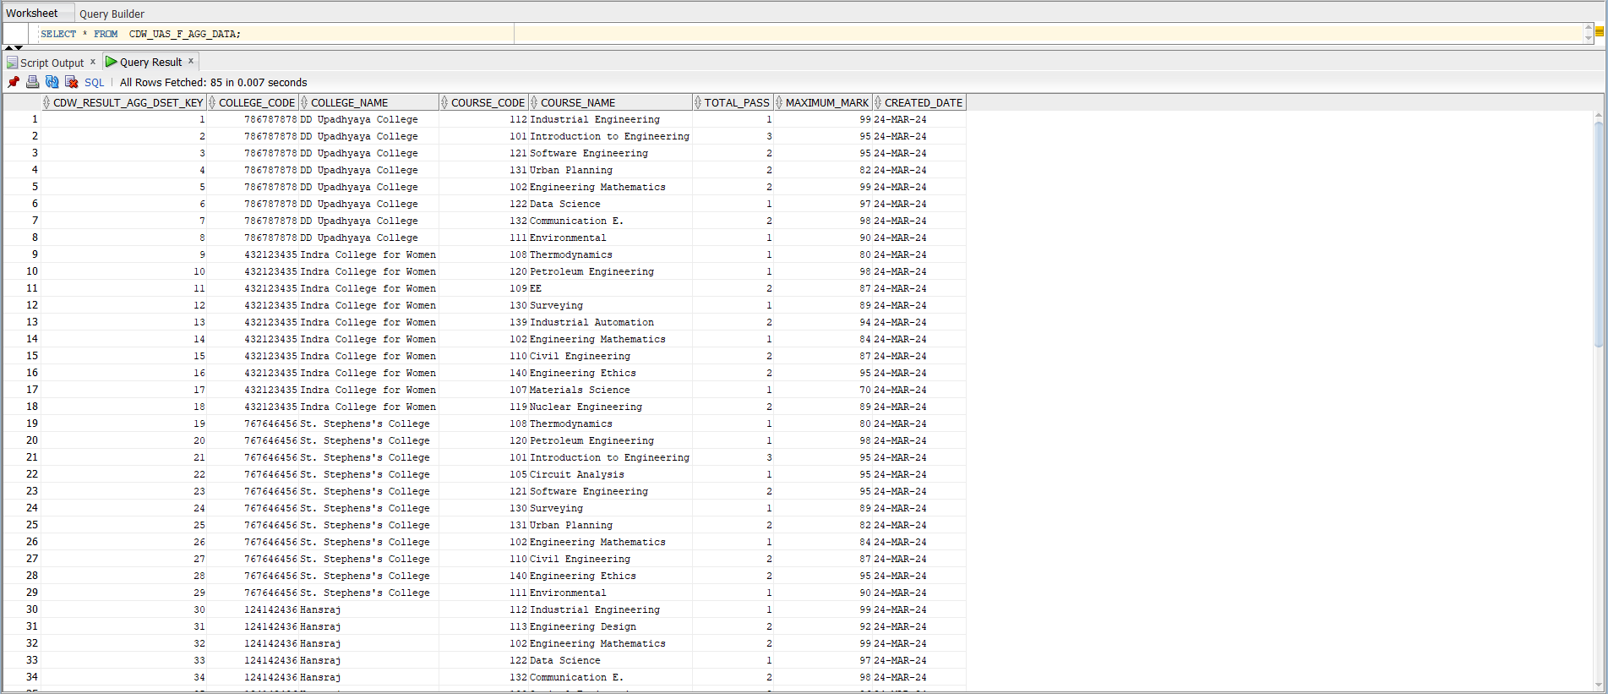
OUTPUT M8 :- Final Result

Slide 43
CONCLUSION:-
As per the requirements I have successfully upload the source data into targets .
As per the requirements I have clean the data and changed the formats of the sources by using multiple type of transformation .
I have successfully calculated Total number of students passed for each Course in each College .
I have successfully calculated Maximum Mark for each Course taught in each College.

Slide 44
THANK YOU

